Slide 1
Operation Analytics and Investigating Metric Spike
By Bhagyashree parate

Slide 2
Agenda
Case Study 1: Job Data Analysis Tasks: Jobs Reviewed Over Time Throughput Analysis Language Share Analysis Duplicate Rows Detection
Case Study 2: Investigating Metric Spike Tasks: Weekly User Engagement User Growth Analysis Weekly Retention Analysis Weekly Engagement Per Device Email Engagement Analysis

Slide 3
Case Study 1:
Job Data Analysis
Software Used : MySQL Workbench 8.0 CE

Slide 4




Case Study 1: Job Data Analysis
Jobs Reviewed Over Time: Write an SQL query to calculate the number of jobs reviewed per hour for each day in November 2020.
Outpu:t
Query :

Slide 5
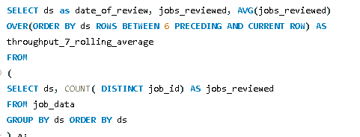
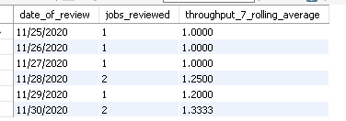
Throughput Analysis:
Write an SQL query to calculate the 7-day rolling average of throughput. Additionally, explain whether you prefer using the daily metric or the 7-day rolling average for throughput, and why.
Query:
Output

Slide 6

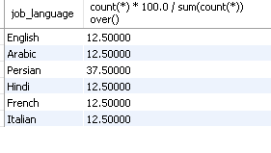
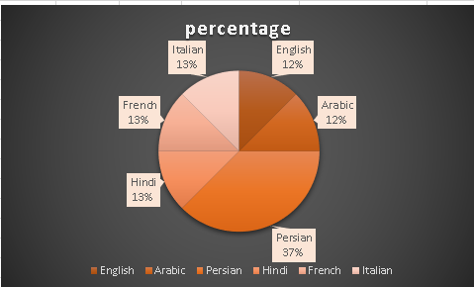
Language Share Analysis:
Write an SQL query to calculate the percentage share of each language in the last 30 days.
- Percentage share of each language: Share of each language for different contents
Query :
Output :

Slide 7

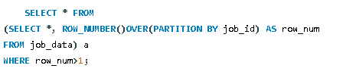
Duplicate Rows Detection:
Write an SQL query to display duplicate rows from the job_data table.
Output:
Query:

Slide 8
Case Study 2:
Investigating metric spike
Software Used : MySQL Workbench 8.0 CE

Slide 9
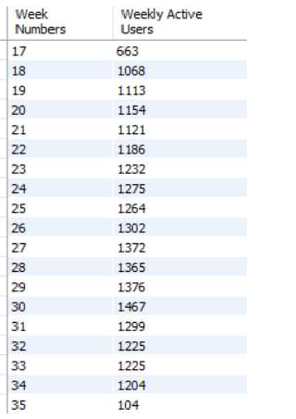

1.User engagement : to measure the activeness of a user. Measuring if the user finds quality in a product/service
Output:
Query:

Slide 10
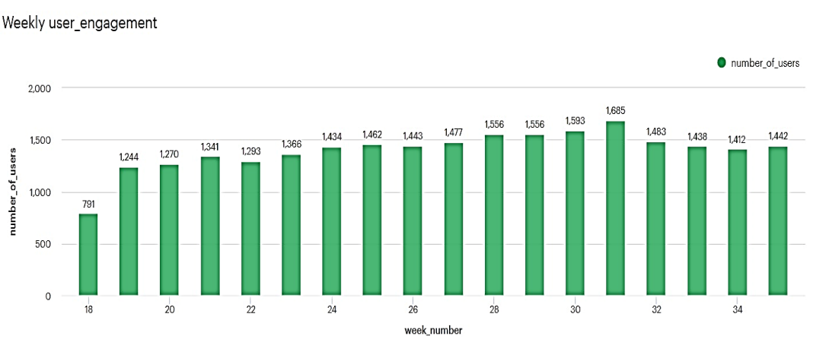
Calculate the weekly user engagement?

Slide 11
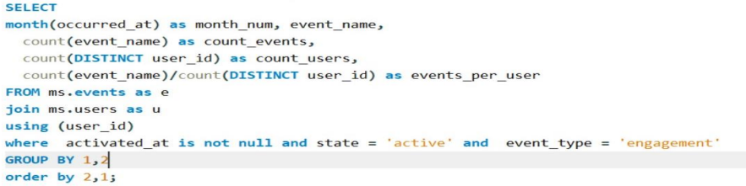
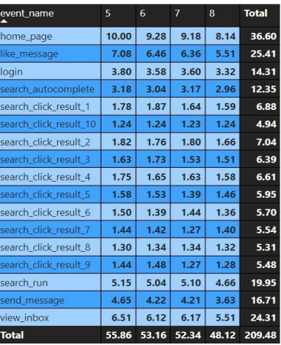
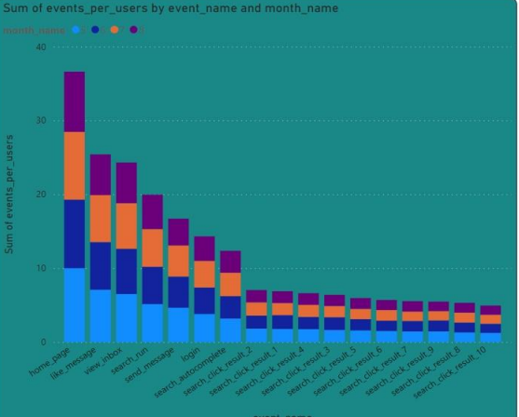
User Growth Analysis: Write an SQL query to calculate the user growth for the product.
Query:

Slide 12
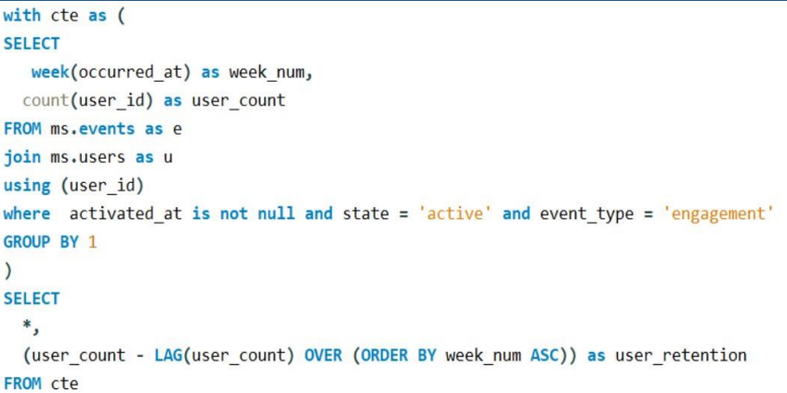
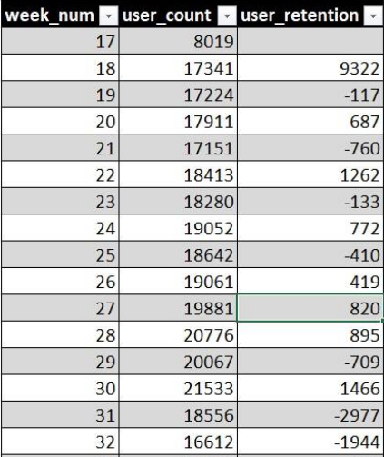
Weekly Retention Analysis: Write an SQL query to calculate the weekly retention of users based on their sign-up cohort.
Query :
Output:

Slide 13
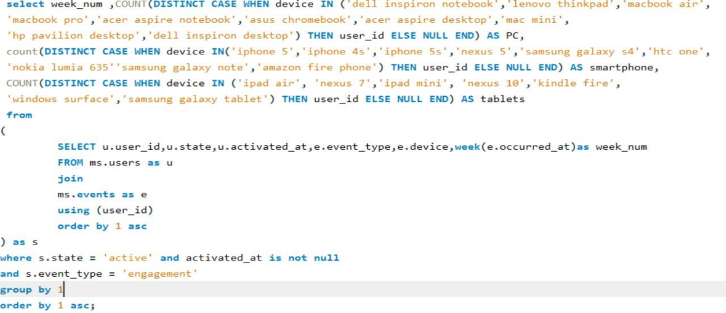
Weekly engagement per device: write an SQL query to calculate the weekly engagement per device.
Query :

Slide 14
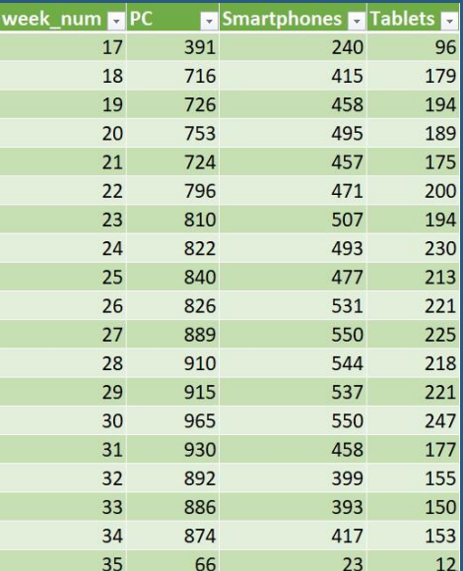
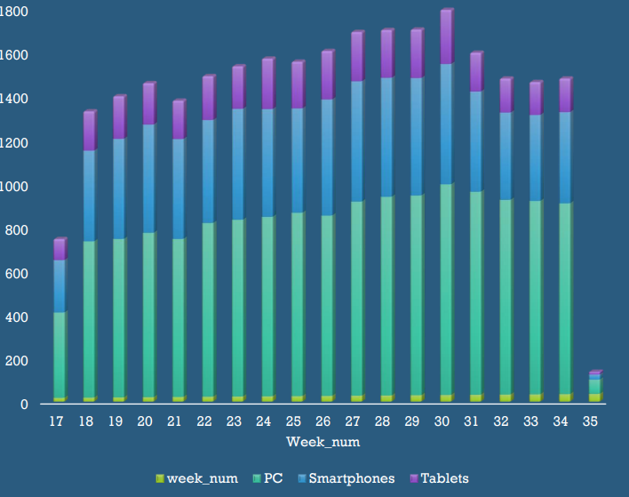

Slide 15
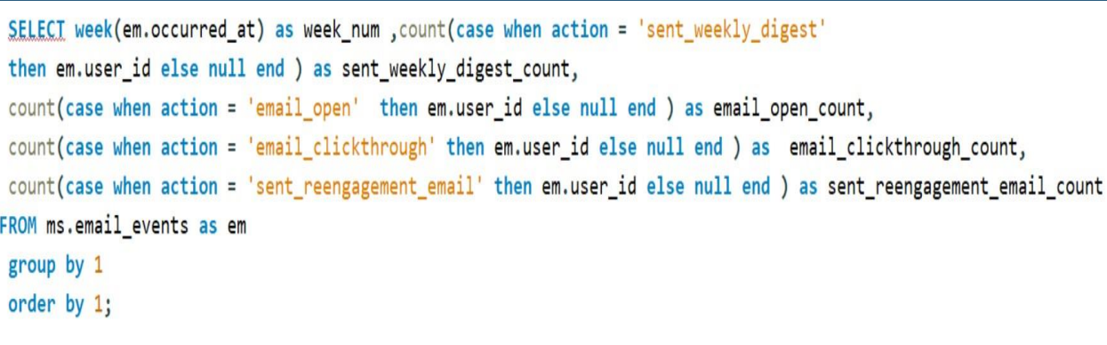
Email engagement analysis: write an SQL query to calculate the email engagement metrics.
Query :

Slide 16
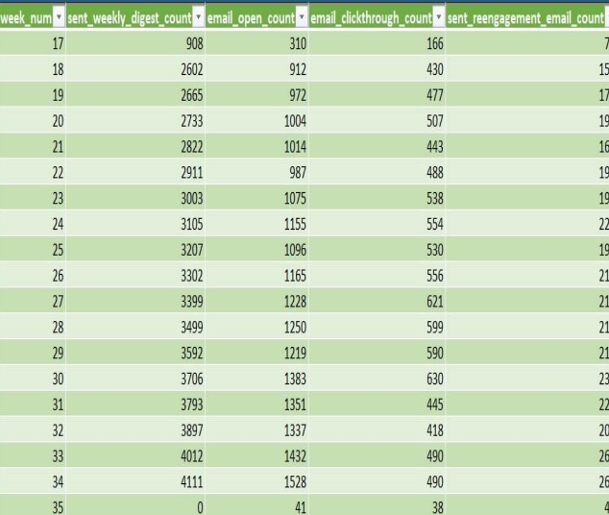
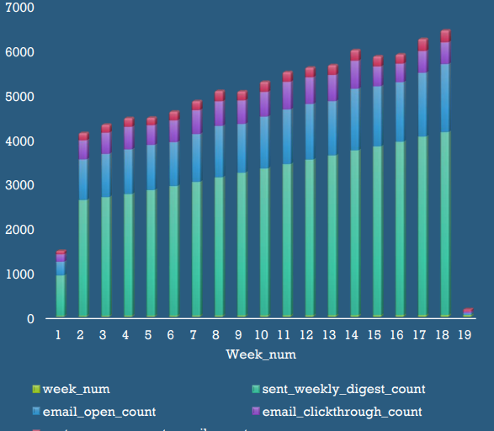
Output :

Slide 17
Thank you

